Slide 1
Pre-Live Session 9
Ben Goodwin

Slide 2
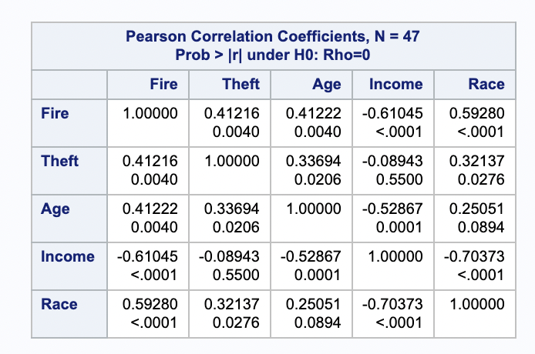
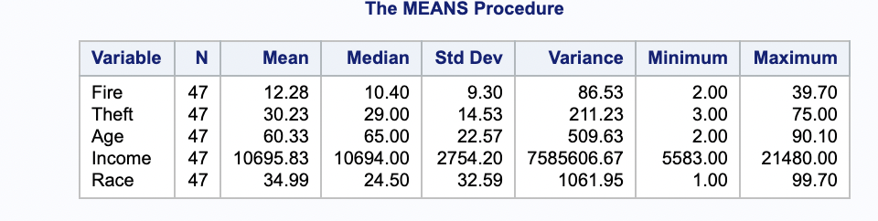
Summary statistics, correlation matrix, and scatterplot matrix

Slide 3
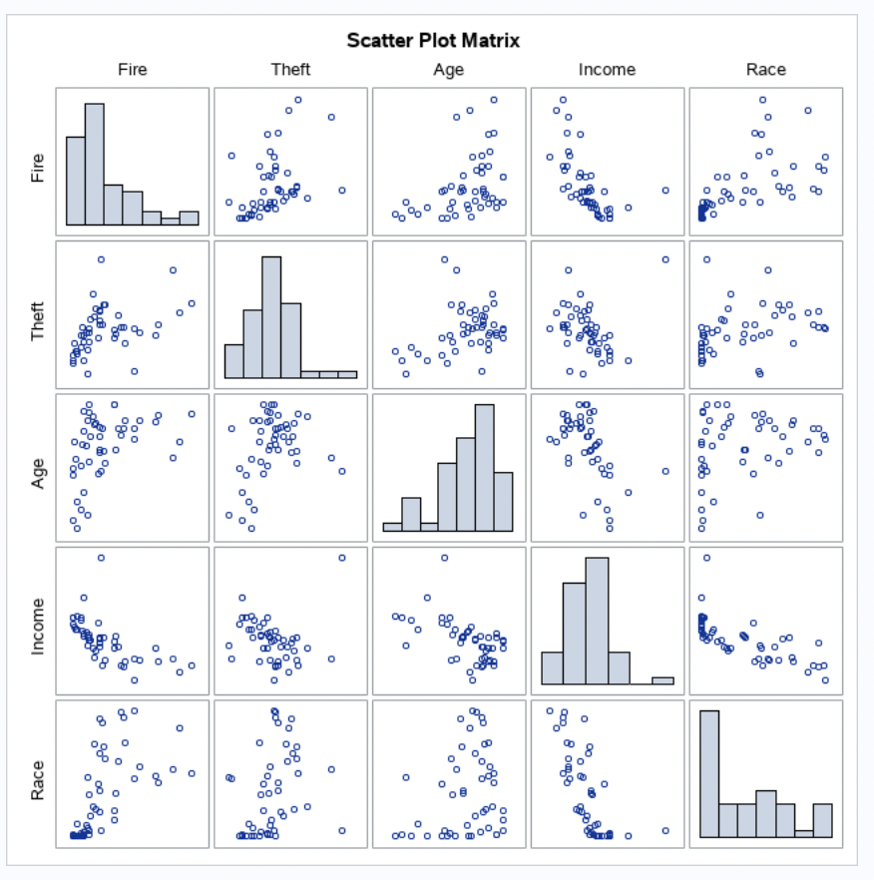
Scatterplot matrix

Slide 4
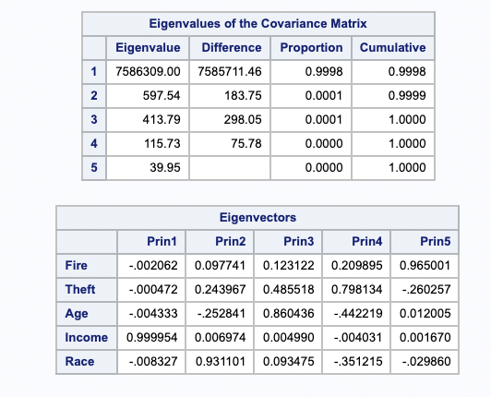
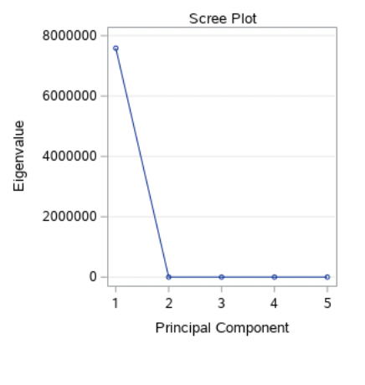
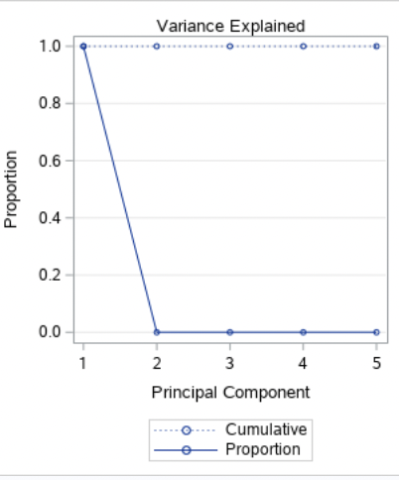
Princomp Procedure/Scree Plot
A. The scree plots of the eigenvalues and the proportion of variance explained tell us that the first principal component explains almost 100% of the variation in the data and could be sufficient to tell our story. The eigenvalue is enormous, and is weird because it encapsulates the whole story.

Slide 5
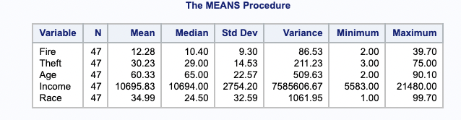
B: Summary Statistics for Principal Components
These values look familiar because despite this data coming from the PCA data, this is the original data.

Slide 6
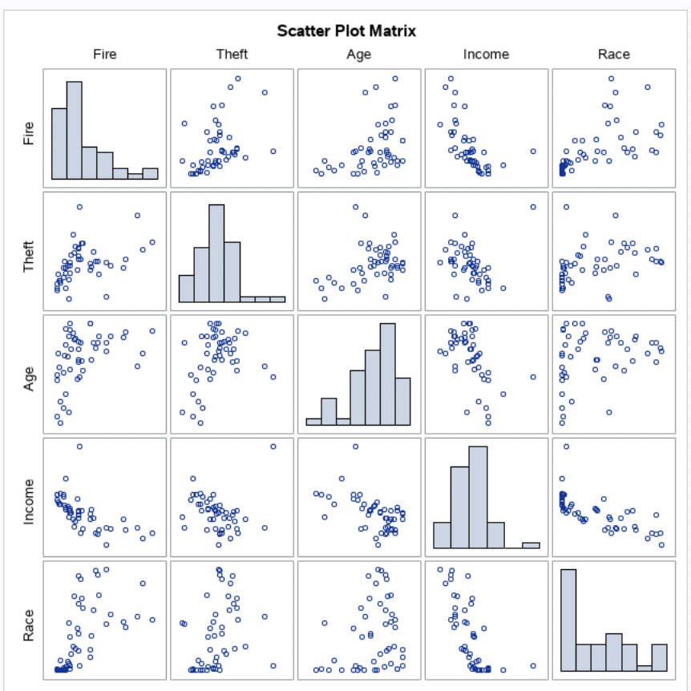
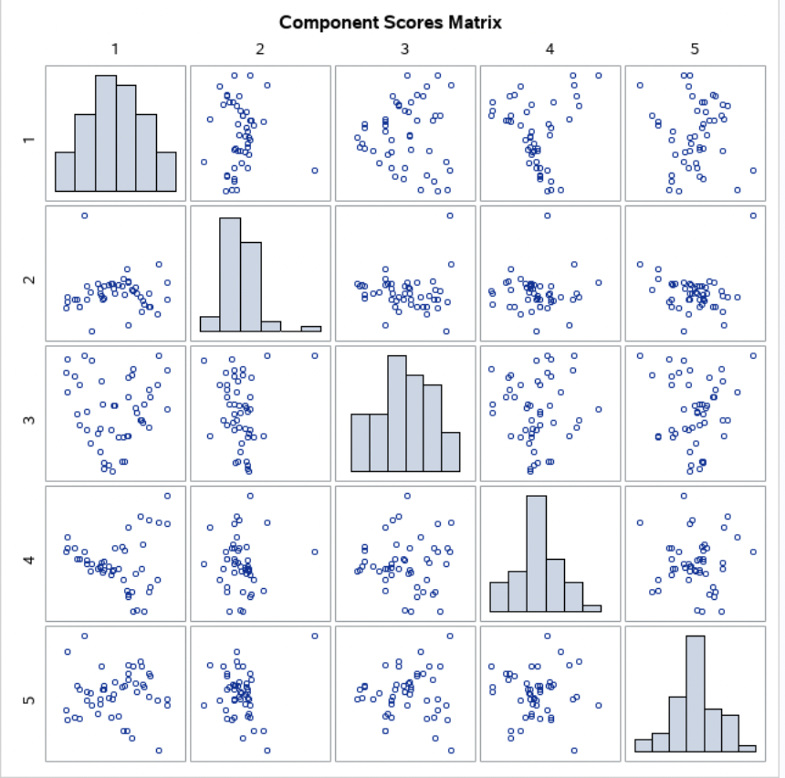
C: Matrix of Raw values and PC’s
The original data has much more visual evidence of correlation. The reduced dimensionality data appears to be free of this trend.

Slide 7
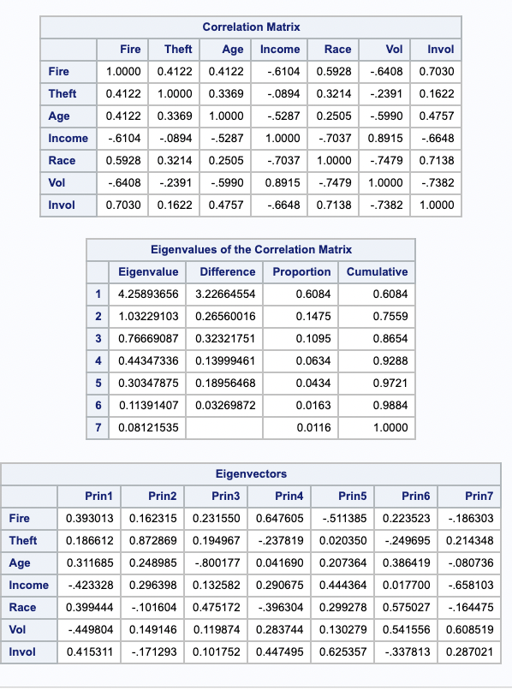
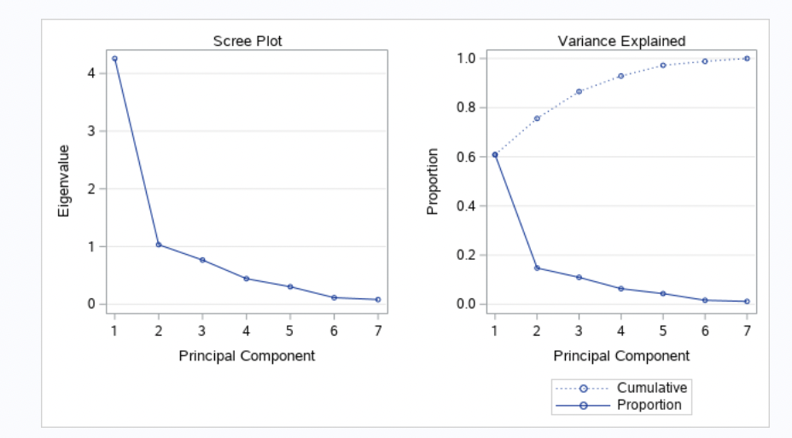
2: Princomp procedure with the “cov” option removed
The difference here is that the first princomp no longer accounts for as much of the variability in the data.

Slide 8
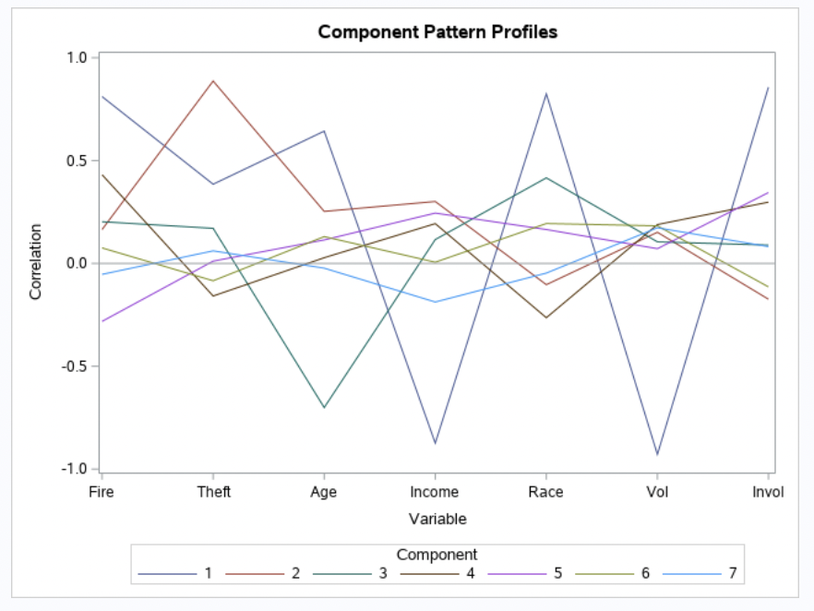
2: Component Profile Plot

